Slide 1









Question
Answering System

Slide 2



The team

Slide 3



The team
KRISHNA VAMSHI 20J41A6732
SAI TEJA 20J41A6738
RITHWIK 20J41A6716
SHASHANK 20J41A6717

Slide 4





Introduction
Question answering systems use natural language(Transformers model) and machine learning algorithms to analyze text and extract relevant information. They then use this information to generate accurate responses to user queries.

Slide 5




Project overview
This project proposes a question answering system that is trained on a custom dataset of question-answer pairs and uses transforms(and attention to improve its performance. The system is also deployed to Streamlit, making it easy to make the system available to others and use it to answer questions.
This approach is more accurate and efficient than previous methods, and it has the potential to be used in a variety of applications, such as customer service, education, research, and personal assistant.

Slide 6


Problem Statement
Develop a question answering system that can answer factual questions posed in natural language. The system should be able to understand the meaning of the questions, retrieve relevant documents from a corpus of text, and extract the answer from the documents.

Slide 7



Objectives

Slide 8


Objectives
1
2
3
The system should be able to understand a wide range of natural language questions, including questions with multiple parts, questions with negation, and questions that are ambiguous.
The system should be able to retrieve relevant documents from a large corpus of text, even if the documents are not explicitly linked to the questions.
The system should be able to provide a confidence score for each answer, indicating how confident the system is that the answer is correct.

Slide 9
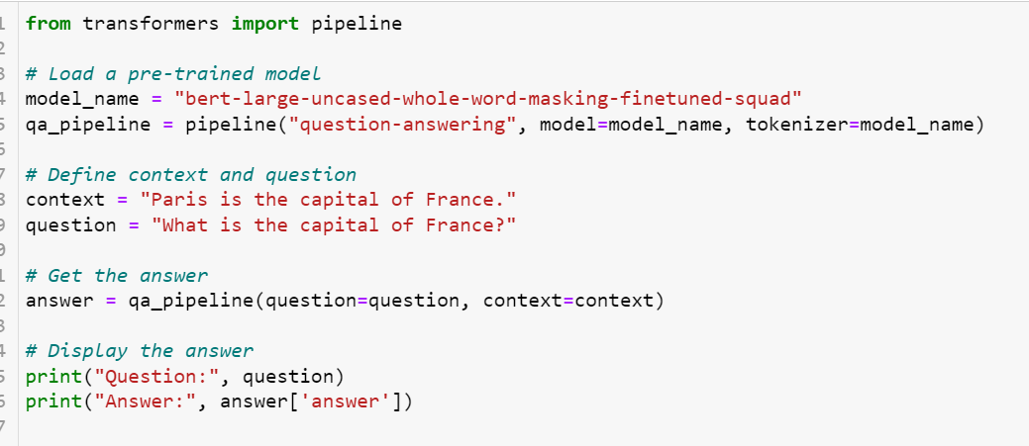

output:

Slide 10
Proposed Method

Slide 11
Proposed Method
Attention-based models use attention mechanisms to focus on the most relevant parts of the question and the document when answering the question.
Transformer models are a type of neural network that are specifically designed for sequence-to-sequence tasks. They have been shown to be very effective for question answering, especially for tasks that require long-term dependencies.

Slide 12
Conclusion

Slide 13




Conclusion
This project developed a transformer-based question answering system that can answer a wide range of questions accurately and efficiently, especially those that require long-term dependencies. This system has the potential to be used in a variety of settings, such as education, research, and business, to help people learn new things, make informed decisions, and solve problems.

Slide 14
Future Scope

Slide 15





Future Scope
Custom training: Train your own model on the SQuAD dataset to improve performance and fine-tune the model to your specific task.
Transforms and attention: Use transforms and attention to improve the model's ability to understand the meaning of the text and focus on the most relevant parts of the text when answering questions.
Streamlit deployment: Deploy the model to Streamlit to make it available to others and use it to answer questions.

Slide 16


THANK YOU

